Slide 1
NEURAL NETWORK PROJECT
ARTIFICAL ROCKET LANDER
Bharath Yuvaraj
Reg No:2316529
PRID:YUVAR11809
Email:by23532@essex.ac.uk​

Slide 2

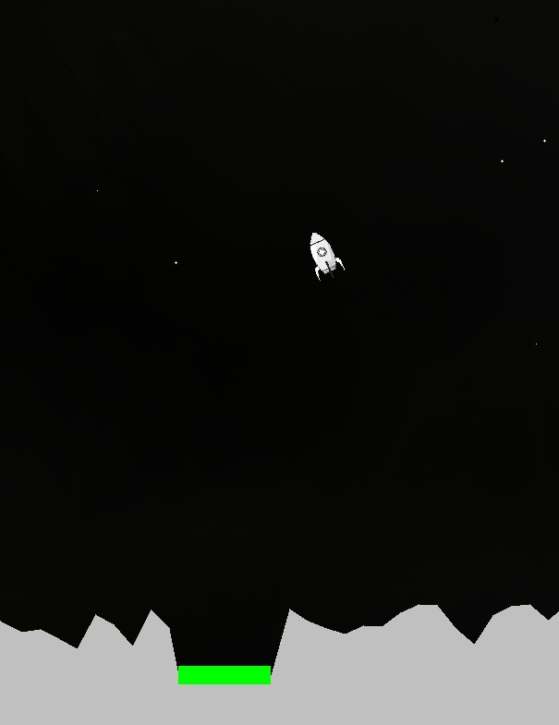
PROJECT OBJECTIVE
Train an Artificial Neural Network using the collected Train Data and Integrate the generated weights with game.
Collect Train Data by safely landing the Lander on the Target
Train an Artificial Neural Network using the collected Train Data and Integrate the generated weights with game.
Collect Train Data by safely landing the Lander on the Target

Slide 3
DATA PARTATION
•Data set has four columns X-axis Y-axis X-velocity Y-velocity.
•Data set is divided into three parts
•Training Set (70%):
•Typically, the largest portion used for training the neural network.
•The model learns patterns from this set.
•Validation Set(15%):
•A smaller subset used to fine-tune the model and prevent overfitting. •Helps in hyperparameter tuning.
•Test Set(15%):
•Remains unseen during training and validation.
•Used to evaluate the model's performance on new data

Slide 4
DATA Pre-processing
1.Reading the Data from CSV File:
•Use libraries like Pandas in Python for efficient data handling.
•Load data into a Data Frame for easy manipulation.
2. Removing Duplicates and NaN Values:
•Use methods like drop duplicates() to eliminate redundant records.
•Employ techniques such as dropna() or imputation methods to handle missing data.
3. Finding Minimum and Maximum Values:
•Use functions like min() and max() for all columns.
4. Normalization of Remaining Values:
•Normalize numerical features to a common scale.
•Common techniques include Min-Max scaling or Z-score normalization.
5. Splitting the Values into Train, Test, and Validation:
•Random Splitting:
•Use functions like train_test_split() to partition the dataset.
•Common ratio: Training (70-80%), Validation (10-15%), Test (10-15%).
6. Generating Train, Test, and Validation CSV Files:
•Saving Processed Data:
•Ensures reproducibility and easy sharing of preprocessed datasets.

Slide 5
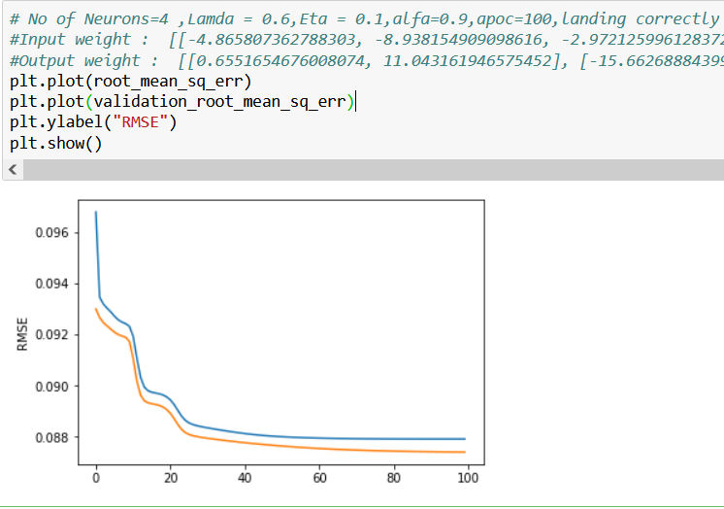
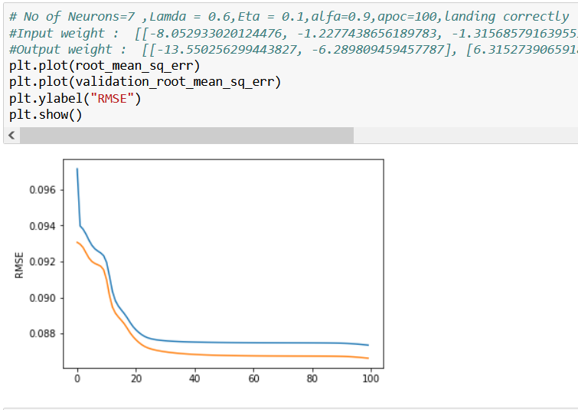
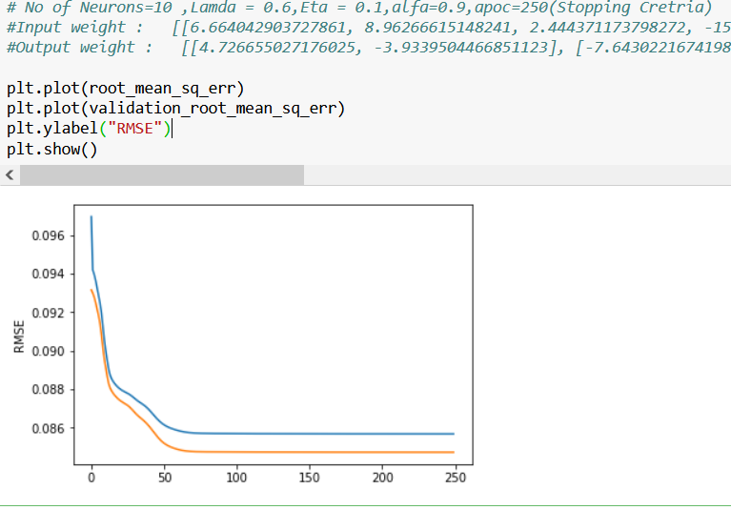




SIZE COMPARSION
Neurons:4
Neurons:7
Neurons:10
The following graphs show the different types of neuron selection of 4,7and 10
In following graphs no of neuron =10 is working more accurately compared to other two neuron selections and RMSE LOSS is 0.86 and the RMSE curve becomes constant at 120 Epoch.

Slide 6
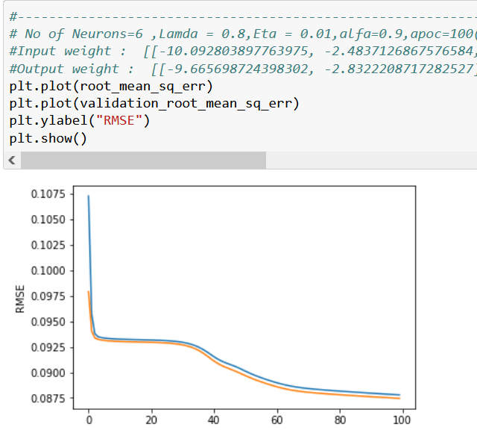
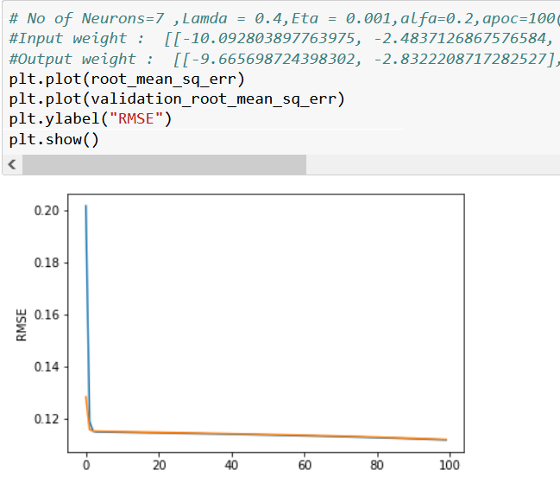
Hyper-parameter Justification
Model with hidden layer having 10 neurons has performed well compared to other models
Lamda values used in this model is 0.6
After doing training and validation for different model with momentum rate and learning rate, model is performing well with learning rate 0.1 and momentum rate 0.9
The model with all these parameters has least RMSE LOSS and working well with all possible values.

Slide 7
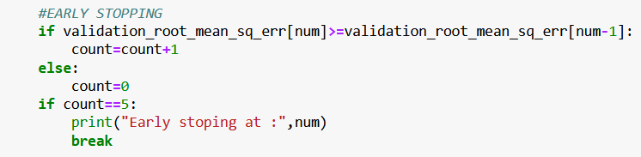
Stopping Criteria
In our model with a hidden layer of 10 neurons, the incorporation of a lambda value of 0.6 for regularization, coupled with many hyperparameter tuning process yielding a learning rate of 0.1 and momentum rate of 0.9, has resulted in exceptional performance, showcasing the model's superiority with the least RMSE loss and robustness across diverse scenarios, making it the optimal choice for our predictive analytics task."
This code is used for validation error over iterations, and if the error hasn't improved for five consecutive iterations, it triggers early stopping. This can help prevent overfitting and speed up the training process by stopping when further iterations may not lead to significant improvements

Slide 8
ARCHITECTURE
Data Pre-process
Feedforward Process
Back-Propagation
Removing Duplicates and NaN Values::.
Employ techniques such as dropna() or imputation methods to handle missing data.
Use functions like min() and max() for all columns.
Splitting the Values into Train, Test, and Validation:
Generating Train, Test, and Validation CSV Files
​
calculation of Weight multiplication from input to hidden layer
Activation hidden layers
calculation of Weight multiplication from hidden layer to output layer
Calculated predicated output
Error calculation
​
Calculate Local gradient
Weight updating from output layer to hidden layer
Adding old weight to new weight
Calculate Hidden gradient
Weight updating from hidden to input layer
Adding old weights to new weights
Initializing the new calculated weights to old weights
​
​
RMSE calculation
GAME INTERGRATION
This can help prevent overfitting and speed up the training process by stopping when further iterations may not lead to significant improvements
Inserting the last updated input and output weights to the neural net holder file ​

Slide 9
Thank you

